Slide 1
AI/ML Fundamentals
Lecture I
Alexei Prokudin
PHYS496

Slide 2

Artificial Intelligence (AI) is a branch of computer science that focuses on creating systems capable of performing tasks that normally require human intelligence. These tasks include learning from experience, reasoning, problem-solving, understanding natural language, perception, and decision-making.

Slide 3

Machine Learning (ML): A subset of AI where algorithms learn from data and make predictions or decisions based on that data.
The key aspect of ML is that the algorithms are performing the tasks that they were not specifically coded for.

Slide 4
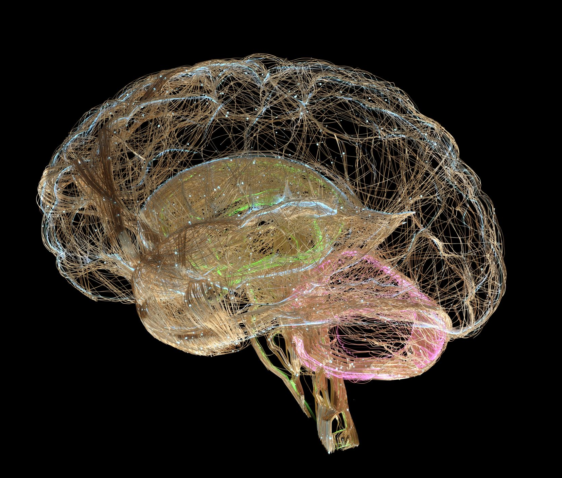
Neural Networks:
A type of machine learning inspired by the structure of the human brain.

Slide 5
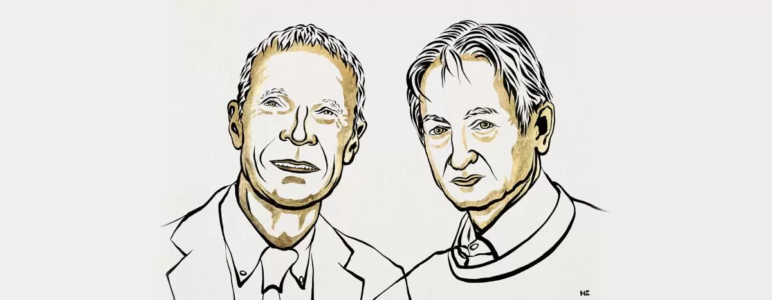
https://www.nobelprize.org/uploads/2024/10/popular-physicsprize2024-2.pdf

Slide 6
https://www.nobelprize.org/uploads/2024/10/popular-physicsprize2024-2.pdf

Slide 7
https://www.nobelprize.org/uploads/2024/10/popular-physicsprize2024-2.pdf

Slide 8

Disclaimer
AI/ML is a large, complex, rapidly changing field.
Much of what you find today may be obsolete in a matter of months.
Our course, instead, should be viewed as a dip in the shallow end of a new pool. I will try to present more foundational things and give a chance to explore these concepts in a more curated way, but the main idea is to dive in.
Rule 0: Be willing to be wrong
Rule 1: Know your tools
Rule 2: Know your data

Slide 9
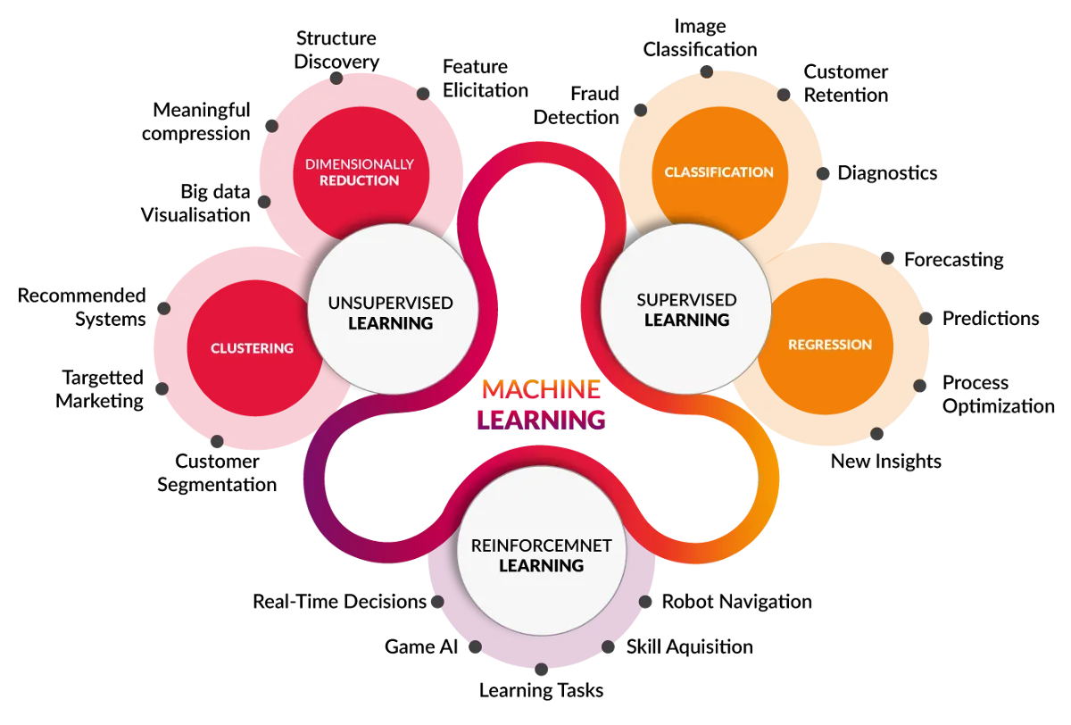

Slide 10
We will study just one
particular aspect of ML
related to supervised learning

Slide 11
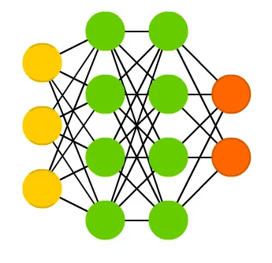
FUNDAMENTALS
Neural Network
DATA
OUTPUT
LOSS FUNCTION
BACK PROPAGATION

Slide 12
DATA
The preparation of data for training a neural network involves several key steps to ensure the data is in the right format and quality for the model to learn effectively.
Data Cleaning
Clean the raw data by handling any errors, missing values to ensure it is suitable for training.
Data Transformation
Transform the data into a format that the neural network can process.
Normalization/Standardization: Scale numerical values so that they fit within a specific range (e.g., between 0 and 1 for normalization or with zero mean and unit variance for standardization).

Slide 13
DATA
Splitting the Data
Split the data into different sets to ensure the model generalizes well and does not overfit.
Training set: Used to train the model (typically 70-80% of the data).
Validation set: Used to tune hyperparameters and evaluate the model during training (typically 10-15% of the data).
Test set: Used to evaluate the final model performance after training (typically 10-15% of the data).
Batching and Shuffling
For large datasets, the training data is split into smaller batches to be processed in parts, rather than all at once. Shuffling the data ensures that the model does not learn patterns based on the data order.
Batching: Divide the data into batches (e.g., 32, 64, or 128 samples per batch).
Shuffling: Randomly shuffle the dataset before creating batches to prevent any sequence bias.

Slide 14
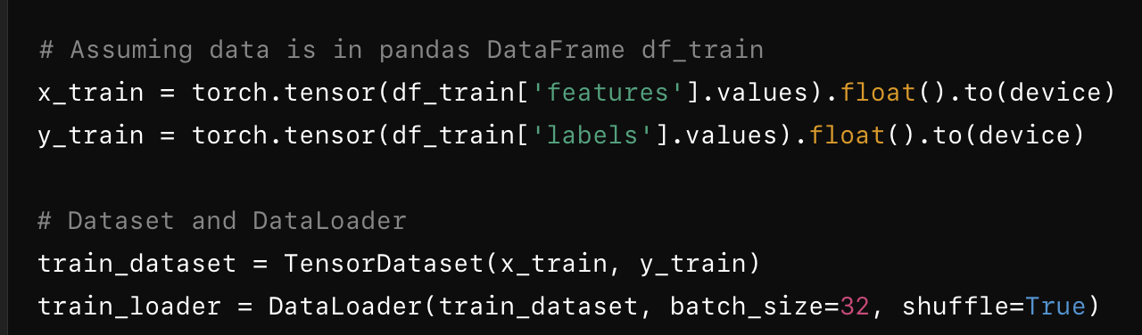
DATA
Loading the Data into the Model
Once the data is preprocessed, it is loaded into data structures that the neural network framework can handle (e.g., torch.Tensor in PyTorch or numpy.ndarray in TensorFlow).
In frameworks like PyTorch or TensorFlow, you might use utilities like DataLoader (PyTorch) or tf.data.Dataset (TensorFlow) to efficiently load batches of data during training.
Example: Loading batches of images into memory for training a convolutional neural network (CNN).

Slide 15
NEURAL NETWORK
In a fully connected (dense) layer of a neural network, each neuron in one layer is connected to every neuron in the next layer. The connections are represented by weights. When the inputs (often represented as a vector) are passed through the network, the operation performed is:
Dot product (matrix multiplication): The input vector is multiplied by the weight matrix. This is a dot product between the input vector and the weight matrix for each neuron in the next layer.
Addition of bias: A bias term is added to the result of the dot product.
Activation function: Afterward, the result is passed through an activation function, such as ReLU, sigmoid, or tanh.

Slide 16
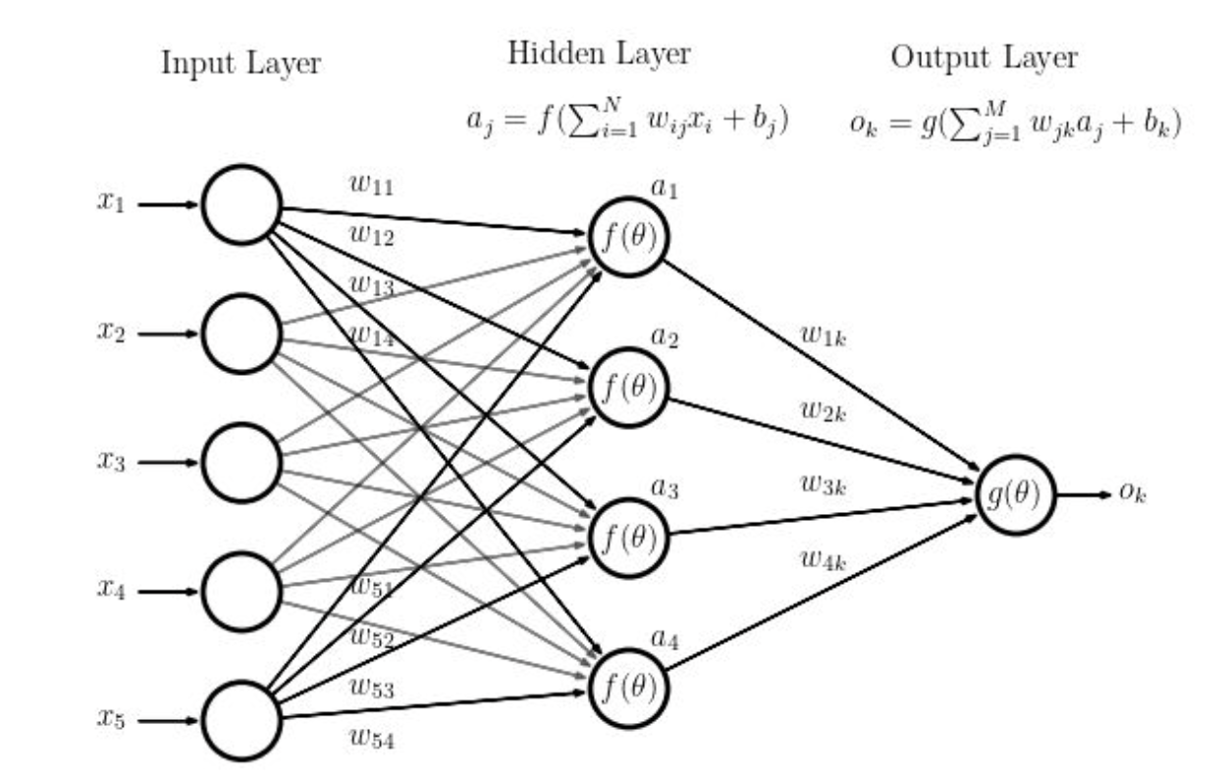
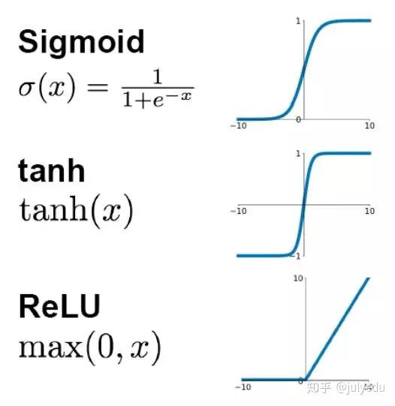
NEURAL NETWORK
The weights and biases can be adjusted, and these adjustments are called learning

Slide 17
LOSS FUNCTION
The loss function is the mathematical way of telling an AI what to learn. Wrong loss function can have catastrophic outcomes
Purpose of the Loss Function:
The loss function quantifies the difference between the model's predictions and the actual values (ground truth).
During training, the model tries to minimize this difference by adjusting its internal parameters (weights and biases).
It provides a numerical value (loss) that the optimization algorithm (e.g., gradient descent) uses to update the model’s parameters.

Slide 18
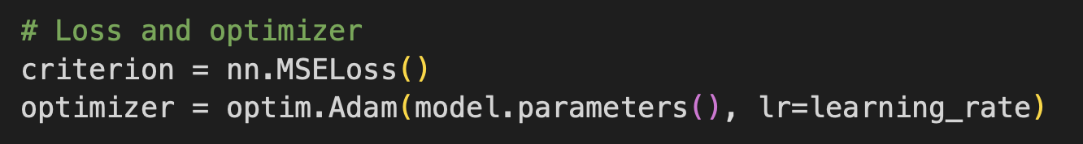
BACKPROPAGATION
Backpropagation is a key algorithm used to train neural networks. It calculates the gradient of the loss function, enabling the network to adjust its weights and biases in order to minimize the loss and improve performance. Backpropagation works in conjunction with an optimization algorithm, such as gradient descent, or one of its variants like Adam.
Forward Pass:
In the forward pass, the input data is passed through the network layer by layer, and the network makes predictions based on its current weights and biases.
The output is compared to the actual target value using a loss function, which measures how far the predicted output is from the true value.
Backward Pass (Backpropagation):
Once the loss is computed in the forward pass, the backward pass (backpropagation) begins.
The goal is to determine how changing each weight and bias would affect the loss, which tells the network how to adjust the weights to reduce the loss.

Slide 19
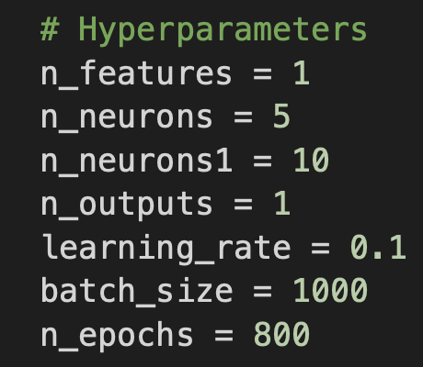
HYPERPARAMETERS
Hyperparameters are parameters in machine learning models that are set before training and cannot be learned directly from the data during the training process. Unlike model parameters (like weights and biases), which are learned, hyperparameters control the behavior of the learning algorithm and influence how the model is trained.
Tuning Hyperparameters:
Because hyperparameters are not learned automatically, they need to be tuned through experimentation or optimization techniques such as:
Grid Search: Trying all combinations of hyperparameter values.
Random Search: Randomly selecting combinations of hyperparameter values.
Bayesian Optimization: A more advanced technique that models the performance of different hyperparameter values to find the best ones more efficiently.
Hyperparameters have a critical impact on both the training process and the performance of the model. Finding the right combination is often key to building a well-performing model.

Slide 20
HYPERPARAMETERS
Key Types of Hyperparameters:
Learning Rate:
Controls how much to adjust the weights of the network with respect to the loss gradient.
A small learning rate can result in slow convergence, while a large one can lead to overshooting and unstable training.
Batch Size:
Refers to the number of training examples used to calculate the gradient in a single update during training.
Smaller batches lead to more updates (and noise) in learning but might generalize better. Larger batches stabilize learning but may converge to suboptimal solutions.
Number of Epochs:
Defines how many times the entire training dataset is passed through the neural network during training.
Too few epochs may result in underfitting, while too many can lead to overfitting.

Slide 21
HYPERPARAMETERS
Key Types of Hyperparameters:
Number of Layers and Neurons (Network Architecture):
Specifies the depth (number of layers) and width (number of neurons per layer) of the network.
A deeper and wider network can model more complex functions but may require more data and computational resources.
Activation Functions:
These are used to introduce non-linearity into the network and include functions like ReLU, sigmoid, or tanh.
Choosing an appropriate activation function can significantly affect learning performance and convergence.
Dropout Rate:
Dropout is a regularization technique that randomly disables a fraction of neurons during training to prevent overfitting.
The dropout rate is the probability that a neuron is "dropped" during an update. Common values are between 0.2 and 0.5.

Slide 22
HYPERPARAMETERS
Key Types of Hyperparameters:
Optimizer Type:
Determines how the model’s parameters (weights and biases) are updated.
Examples include Stochastic Gradient Descent (SGD), Adam, RMSprop, etc. Different optimizers can lead to different learning dynamics and performance.
Regularization Parameters:
These help prevent overfitting by penalizing large weights or making the model simpler.
Common methods include L2 regularization (weight decay) and L1 regularization (lasso), with associated hyperparameters that control the strength of regularization.
Momentum:
Momentum helps accelerate gradient descent by taking the past gradient direction into account to prevent oscillations and speed up convergence.
The momentum hyperparameter controls the influence of past gradients.
Weight Initialization Methods:
How the initial values of weights are set can affect training convergence.
Methods like Xavier initialization or He initialization are popular and tuned to the specific activation functions used.

Slide 23

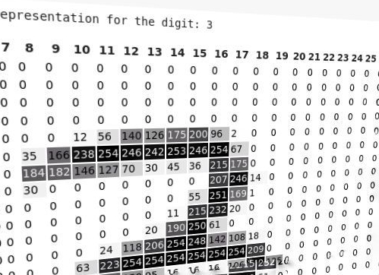
WHAT IS PYTORCH?
Open-source machine learning library
Developed by Meta’s AI Research Lab
Leverages power of GPUs
Automatic computation of gradients
Easier to test and develop new ideas

Slide 24
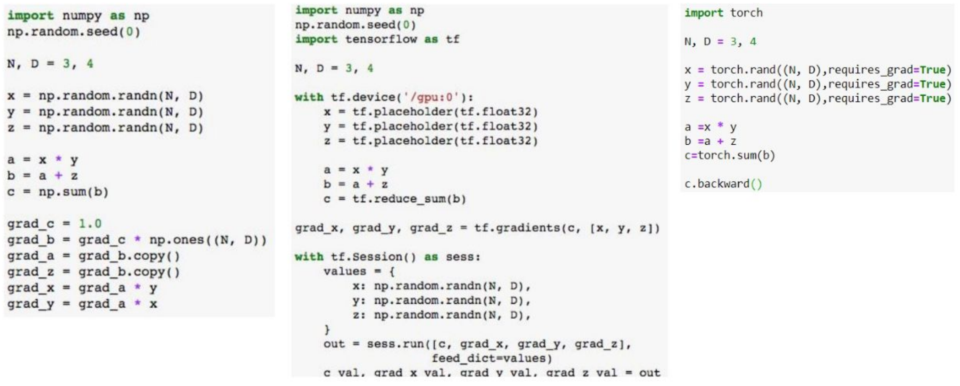

WHY PYTORCH?
“PyThonic” – easy to use
GPU support – models run fast
Calculation of the gradient is automatic
Prebuilt infrastructure abstracted for you
Similar to NumPy

Slide 25

https://chatgpt.com
ChatGPT is a conversational AI model developed by OpenAI, based on the GPT (Generative Pre-trained Transformer) architecture.
It is built on top of large-scale language models, specifically versions of OpenAI's GPT architecture (e.g., GPT-3, GPT-4).
ChatGPT has a variety of applications, including programming assistance, such as helping with code writing, debugging, and explaining programming concepts.
The use of ChatGPT or any other large language model (LLM) is allowed and encouraged in this course. Feel free to use it as a learning tool and a co-pilot. However, be sure it enhances, rather than replaces, your critical thinking and personal learning process.

